Slide 1
깐뷰
20212956 구여진
20212957 권보미

Slide 2

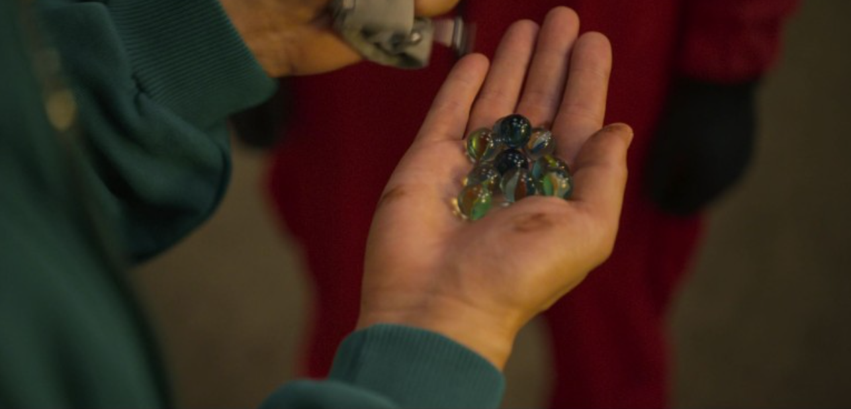
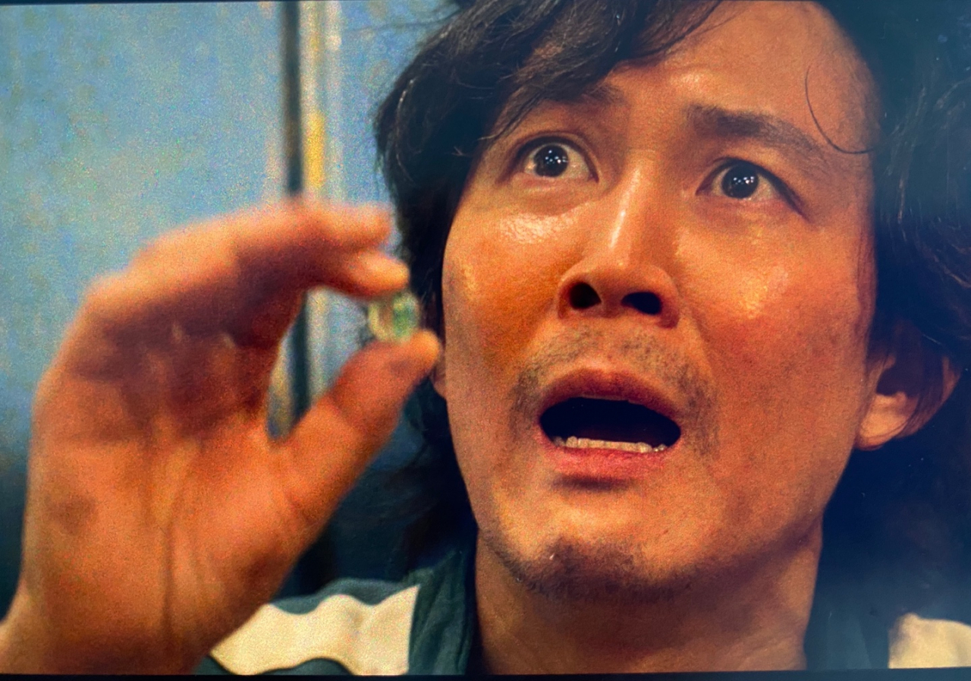

Slide 3
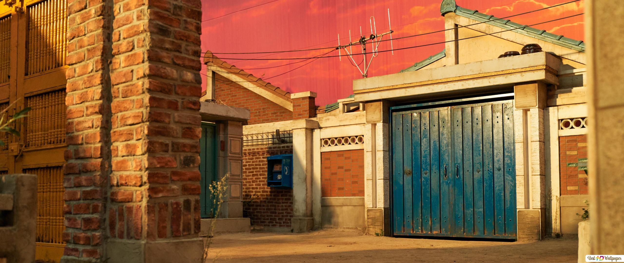
구슬게임

Slide 4
~과제내용~

Slide 5



사용하는 모듈
PyQt5
time
random

Slide 6

time module

Slide 7
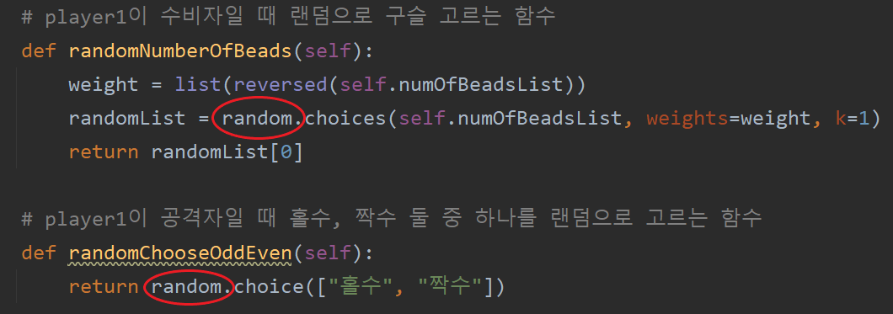
random module

Slide 9

And here comes the slide title!
Do you know what helps you make your point clear? Lists like this one:
They’re simple
You can organize your ideas clearly
You’ll never forget to buy milk!
And the most important thing: the audience won’t miss the point of your presentation

Slide 10
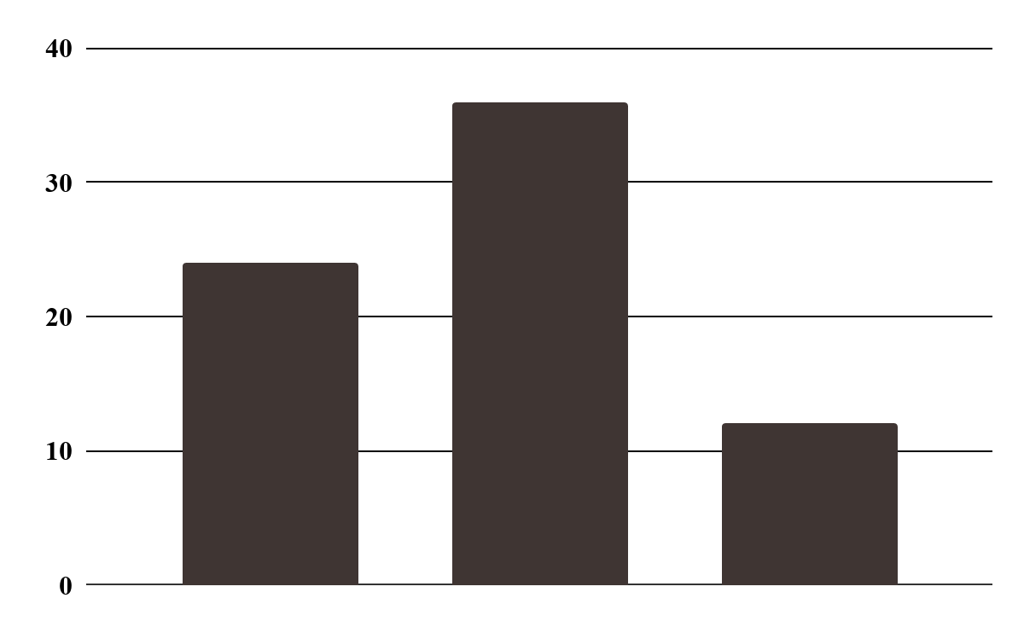
This is a graph
Jupiter
It’s a gas giant and the biggest planet
Venus
Venus has a beautiful name
Mars
Jupiter
Venus
Mars
Mars is actually a very cold place
Follow the link in the graph to modify its data and then paste the new one here. For more info, click here

Slide 11
Maybe you need to divide the content
Mercury
Venus
Mercury is the closest planet to the Sun and the smallest one
Venus has a beautiful name and is the second planet from the Sun

Slide 12

A picture is worth is a thousand words

Slide 13
Schedule
Phase 1
9:00
10:00
11:00
12:00
Task 1
Task 2
Phase 2
Task 1
Task 2

Slide 14
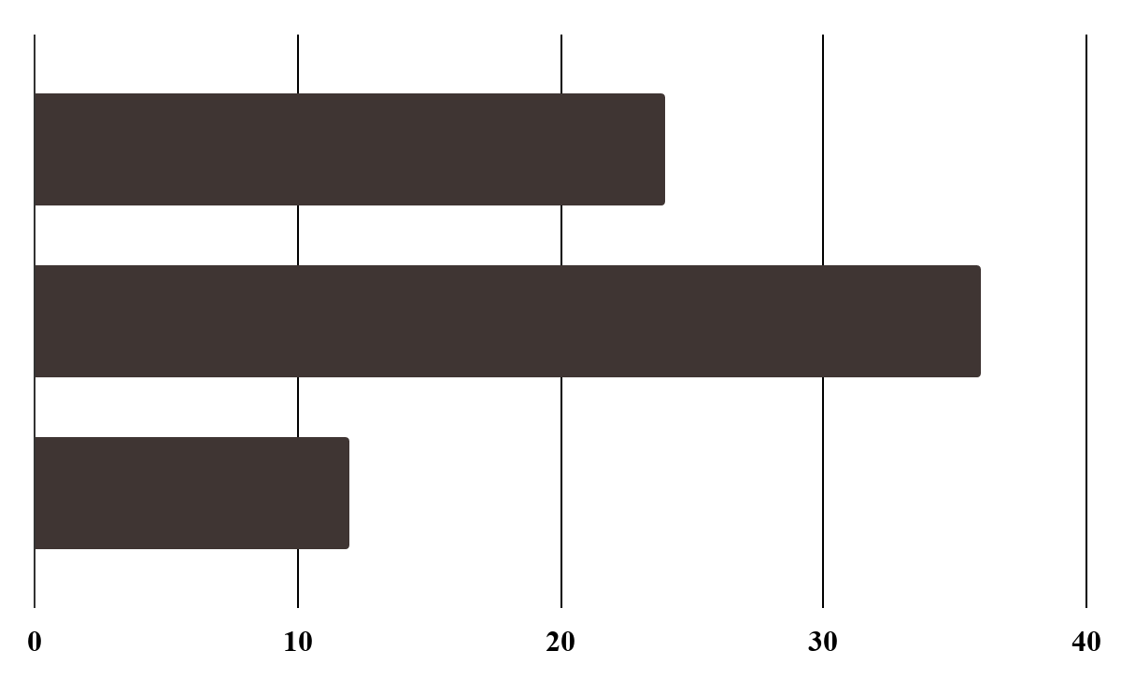
Forecast
1,254
4,215
8,554
Jupiter
It’s a gas giant and the biggest planet
Jupiter
Venus
Venus
Venus has a beautiful name
Mars
Mars
Mars is actually a very cold place
Follow the link in the graph to modify its data and then paste the new one here. For more info, click here

Slide 15
Target
Gender
Age
30%
50%
20%
75%
50%
18 - 25
26 - 35
+36

Slide 16

A picture always reinforces the concept
Images reveal large amounts of data, so remember: use and image instead of long texts

Slide 17
Monthly data
125K
250K
540K
January
June
November
Mars is actually a cold place
Venus has a beautiful name
Mercury is the smallest planet

Slide 18
This is a timeline
Jupiter
Mars
It’s a gas giant and the biggest planet
Mars is actually a very cold place
01
02
03
04
Mercury
Neptune
Is the closest planet to the Sun
Neptune is the farthest planet

Slide 19
This is a table
 | Mars | Venus | Jupiter
Task 1
Task 2
Task 3
Task 4

Slide 20
Percentages
20%
40%
60%
Mars
Venus
Mercury
Mars is actually a cold place
Venus has a beautiful name
Mercury is the smallest planet

Slide 21
Your can use six columns
Mars
Venus
Mercury
Mars is actually a cold place
Venus has a beautiful name
Mercury is the smallest planet
Neptune
Jupiter
Saturn
It’s the farthest planet from the Sun
Jupiter is the biggest planet
This is the ringed one. It’s a gas giant

Slide 22
Awesome Words

Slide 23
This is a map
Jupiter
Venus
Is a gas giant and the biggest planet
Venus has a beautiful name
Mars
Mercury
Mars is actually a very cold place
Mercury is the smallest planet

Slide 24
Your can use four columns
Mars
Venus
Mars is actually a cold place
Venus has a beautiful name
Neptune
Jupiter
It’s the farthest planet from the Sun
Jupiter is the biggest planet

Slide 25
This is an infographic
Mars
Venus
01
02
Mars is actually a very cold place
Venus has a beautiful name
Jupiter
Saturn
03
04
It’s a gas giant and the biggest
It’s the planet with rings

Slide 26
Our goals
Mars
Venus
Mars is actually a cold place
Venus has a beautiful name
Neptune
Jupiter
It’s the farthest planet from the Sun
Jupiter is the biggest planet

Slide 27
Statistics
 | Phase 1 | Phase 2 | Phase 3
Mercury | 1,254 | 9,145 | 8,145
Mars | 5,214 | 6,541 | 3,214
Saturn | 3,418 | 3,214 | 5,415

Slide 28
24h 37m 23s
333,000.000
386,000 km
Earths is the Sun’s mass
is Jupiter's rotation period
is the distance between the Earth and the Moon

Slide 29
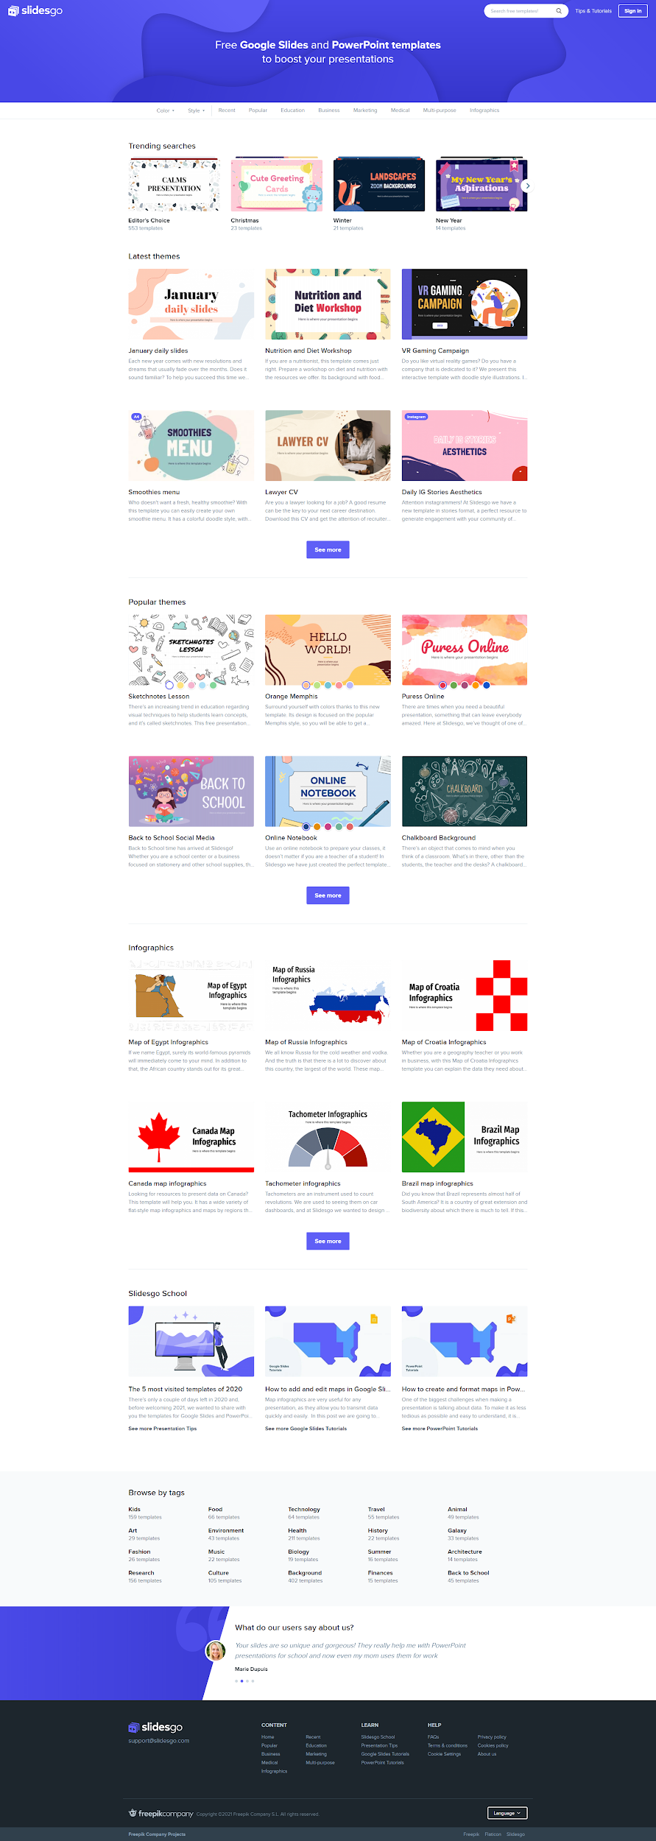
Desktop software
You can replace the image on the screen with your own work

Slide 30
Tablet app
You can replace the image on the screen with your own work

Slide 31

Mobile web
You can replace the image on the screen with your own work

Slide 32
감사합니다

